Slide 1
2.3 Global optimization methods

Slide 2
In this Section we describe the first approach one might take to approximately minimize an arbitrary function: evaluate the function using a large number of input points and treat the input that provides the lowest function value as the approximate global minimum of the function.
This idea mimics how we as humans might find the approximate minimum of a function 'by eye' - i.e., by drawing it and visually identifying its lowest point.

Slide 3
While easy to implement and perfectly adequate for functions having low-dimensional input, this naturally zero-order framework fails miserably when the input dimension of a function grows to even moderate size.
This happens essentially for the same reason our ability to visually identify an approximate minimum of a function fails once the input size is greater than 2 or 3: the number of inputs to examine simply becomes infeasible.

Slide 4
Choosing input points

Slide 5
To determine the smallest point of a function taking in one or two inputs we - as humans - can simply draw the function and determine 'by eye' where the smallest point lies.
We can mimic this visual approach by simply evaluating a function over a large number of its input points and designating the input that provides the smallest result as our approximate global minimum.
This approach is called a global optimization method.
How do we choose the inputs to try out with a generic function?

Slide 6
We clearly cannot try them all - even for a single-input function - since there are (technically speaking) an infinite number of points to try for any continuous function.
So - as one might guess - we can take two approaches to choosing our (finite) set of input points to test: we can sample them *uniformly* over an evenly spaced grid, or pick the same number of input points at random.
We illustrate both choices in the example below.

Slide 7
Example: Evaluating a quadratic to determine its minimum

Slide 8
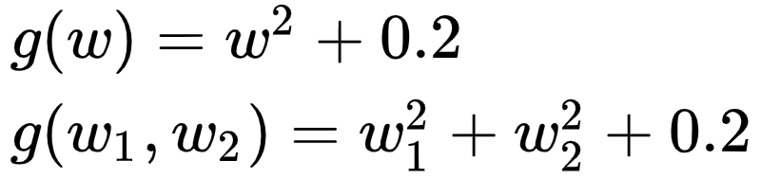
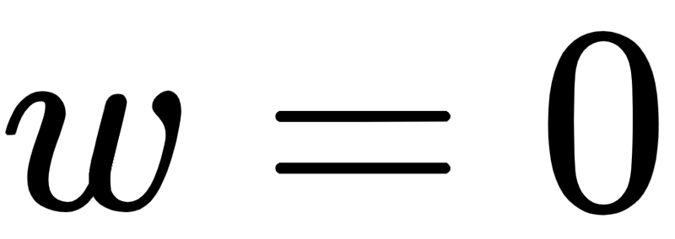
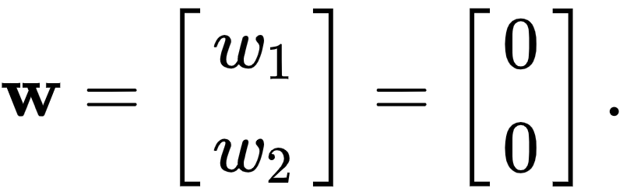
Here we illustrate two sampling methods for finding the global minimum of simple 2-d and 3-d quadratic functions
The former has global minimum at , and the latter at

Slide 9
In the top two panels we illustrate how to evenly sample the input of each function
In the bottom two panels we randomly sample (uniformly at random on the interval [-1,1] in each input axis)

Slide 10
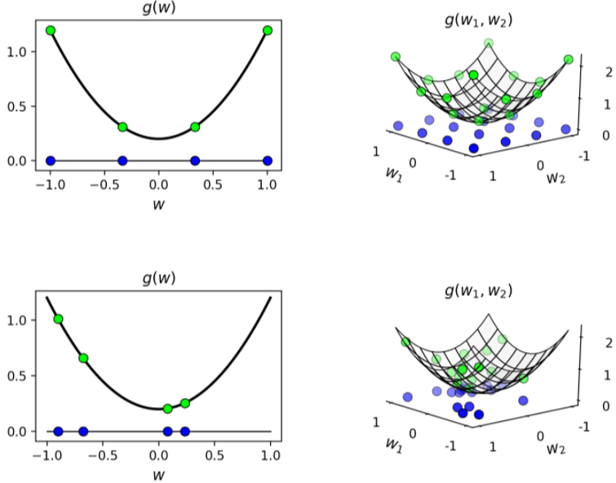

Slide 11

If we take enough samples we could certainly find an input very close to the true global minimum of either function.
For example if we run this experiment again using 20 samples for the 2-d quadratic, and 400 samples for the 3-d quadratic (so that we are sampling with a grid in the case of even sampling), using either approach we are able to find either the global minimum or a point very close to it.

Slide 12
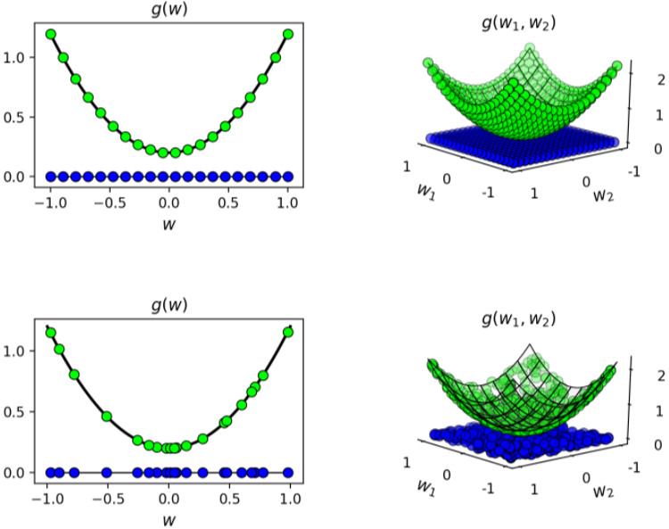

Slide 13

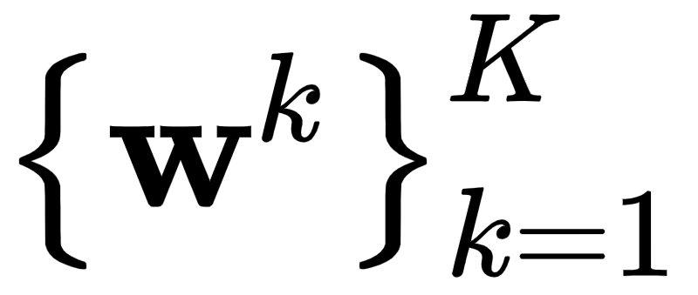
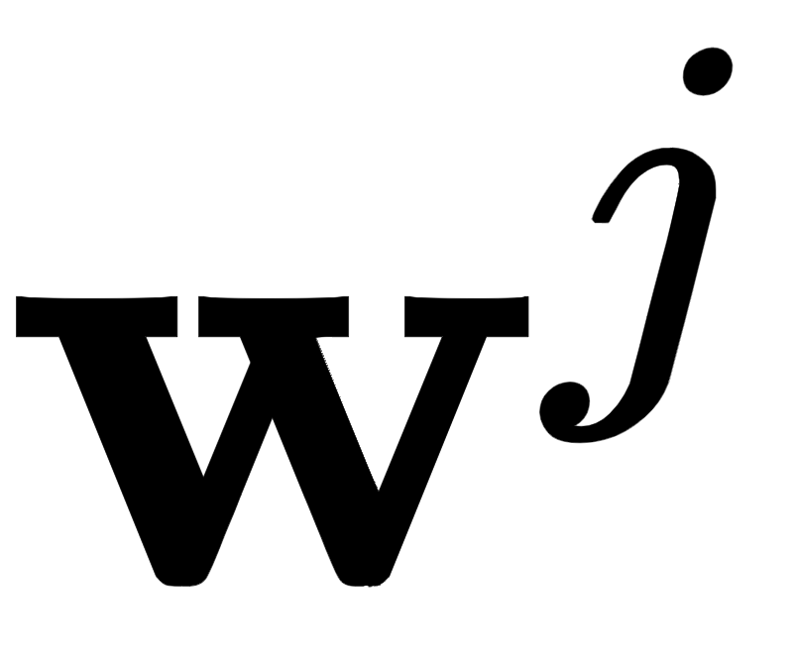
Notice with global optimization we really are employing the simple zero-order optimality condition, from a set of chosen inputs we are choosing the one input lowest on the cost function
This is indeed an approximation to the zero-order optimality condition discussed in the previous Section.

Slide 14
The curse of dimensionality and the failure of global optimization

Slide 15
While this sort of zero-order evaluation works fine for low-dimensional functions, regardless of how the input points are chosen, it fails quickly as we try to tackle functions of larger dimensional input.
This makes them unusable in modern machine learning since the functions we often deal with have input dimensions ranging from the hundreds to the hundreds of millions.

Slide 16
If sampled uniformly we need exponentially more points to sample an input space as its dimension increases, as illustrated below.
Here we sample an input space of dimension 1, 2, and 3, respectively keeping each point a distance d apart (along the coordinate axis).

Slide 17
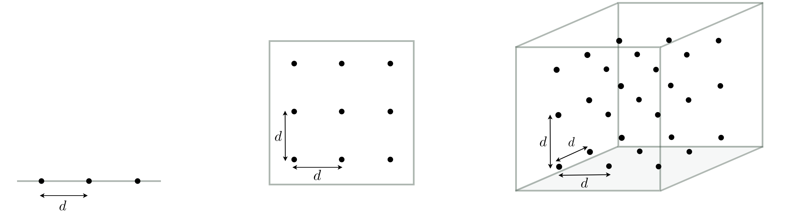
The number of points required to achieve this increases from 3 to 9 to 27 as we increase our input dimension from 1 to 2 to 3.

Slide 18
This issue is not ameliorated if we take samples randomly.
Below we illustrate what happens if we take a fixed number of 10 points and spread them randomly over an input space.
As the dimension of the input space increases the density of our sampling decreases exponentially.

Slide 19
